Slide 1
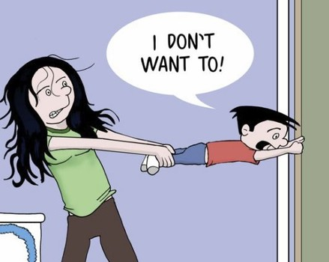
Why do I need to use quantitative research methods?
Larissa Schneider Guilhon
University of Canberra

Slide 2
Definition
From Aliaga and Gunderson (2000):
Quantitative research is ‘Explaining phenomena by collecting numerical data that are analysed using mathematically based methods (in particular statistics).

Slide 3
To answer interesting questions you need data.
To interpret and analyse your data you need to use quantitative research methods.
Therefore…
Quantitative methods are vital to the research process!!!

Slide 4
You need to observe a phenomena (key).
This phenomena is narrowed down to a more specific research question.
E.g.
In education: ‘why do teachers leave teaching?’, ‘what factors influence pupil achievement?’
In health: ‘Does mercury levels affect men and women in the same way?’, ‘Is lung cancer associated with cigarette smoking?’
In economy: ‘Is education level in a country dependent to the economic status?’

Slide 5
How to Think About a Good Phenomena and Research Question?
Best ideas comes from everyday problems.
When an idea comes up, write it down.
Let it lie for a day or two and see if it is worth pursuing.
Talk it through with a colleague.
Outcomes. Ask “What can I hope to accomplish?” or What could this intervention really affect?

Slide 6
Criteria for a good question
Acronym FINER (Hulley and Cummings, 1998, )
- Feasible (adequate subjects, technical expertise, time and money, and scope).
- Interesting to the investigator.
- Novel (confirms or refutes previous findings, provides new findings).
- Ethical.
- Relevant (to scientific knowledge, clinical and health policy, future research directions).

Slide 7
Once your question is defined, think about how it might be answered.
Is the question specific enough?
Does it suggest factors or items that can be measured?
Are these reasonable and acceptable measures?
Sometimes question may have to be modified according to the constraints of:
Time
Budget
Effort to undertake the project.

Slide 8


Slide 9
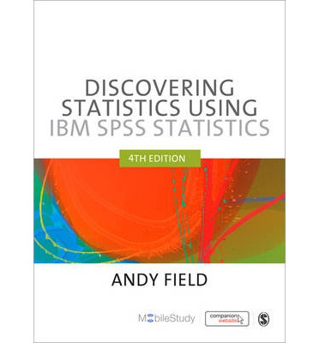

Slide 10
How do I go by answering an interesting question?

Slide 11
Generating theories and testing them
Based on your observations, you build theories.
Big Brother theories:
1st: People with narcissistic personality disorder are more likely to audition for Big Brother.
2nd: Producers of Big Brother are more likely to select people who have narcissistic personality disorder to be contestants than those with less extreme personalities.

Slide 12
Making predictions from these two theories
Prediction from our 1st theory : the number of people turning up for an audition that have narcissistic personality disorder will be higher than the general level in the population (which is 1%).
Prediction from our 2nd theory: the Big Brother selection panel are more likely to choose people with narcissistic personality disorder. Then, the rate of this disorder in the final contestants will be even higher than the rate in the group of people going for auditions.

Slide 13

Any special feelings about these predictions?
A prediction from a theory, is known as hypothesis!
BUT… sometimes a hypothesis is not a hypothesis!!!

Slide 14
Hypothesis
Statements that can be tested using science.
They can be verified using empirical evidence.
Non-hypothesis statements:
The Led Zeppelin reunion concert in London in 2007 was the best gig ever.
Lindt chocolate is the best food.
This is the best “Quantitative Research”workshop in the world ☺

Slide 15
Hypothesis statements:
Watching Curb Your Enthusiasm makes you happy.
Having sex increases levels of the neurotransmitter dopamine.
Turtle lays more eggs than platypus.
But… why are these statements considered hypothesis????
Because you can quantify and measure the variables concerned.

Slide 16
Non-hypothesis statements can be altered to become hypothesis statements
The Beatles were the most influential band ever.
can be restructured to:
The Beatles were the best-selling band ever.

Slide 17
Hypothesis
Null hypothesis: states that an effect is absent.
Alternative hypothesis: states that an effect is present.
- H0: Big Brother constants and member of the public will not differ in their score on personality disorder questionnaires.
- H1: Big Brother constants will score higher on personality disorder questionnaires than members of the public.
Why do we need the null hypothesis???

Slide 18
Write down your own research question and hypothesis

Slide 19

Collect your data

Slide 20
1st Hypothesis: The percentage of people with narcissistic personality disorder will be higher in the audition than the general level in population.
854/ 7662 X100 = 11%
Much higher than the 1% expected.
Hypothesis 1 is supported by data!!!!!

Slide 21
2nd Hypothesis: The Big Brother selection panel have a bias to choose people with narcissistic personality disorder.
9/ 12 X100 = 75%
75% is massive, much higher than the 11% expected.
Hypothesis 2 is supported by data!!!!!
Conclusion: our initial observation was verified by data, then our theory was tested using specific hypothesis that were also verified using data.
Data is VERY IMPORTANT!!!!

Slide 22
On the two slides above, we worked with general hypothesis. Set Ho and H1 for the 2 cases above :

Slide 23
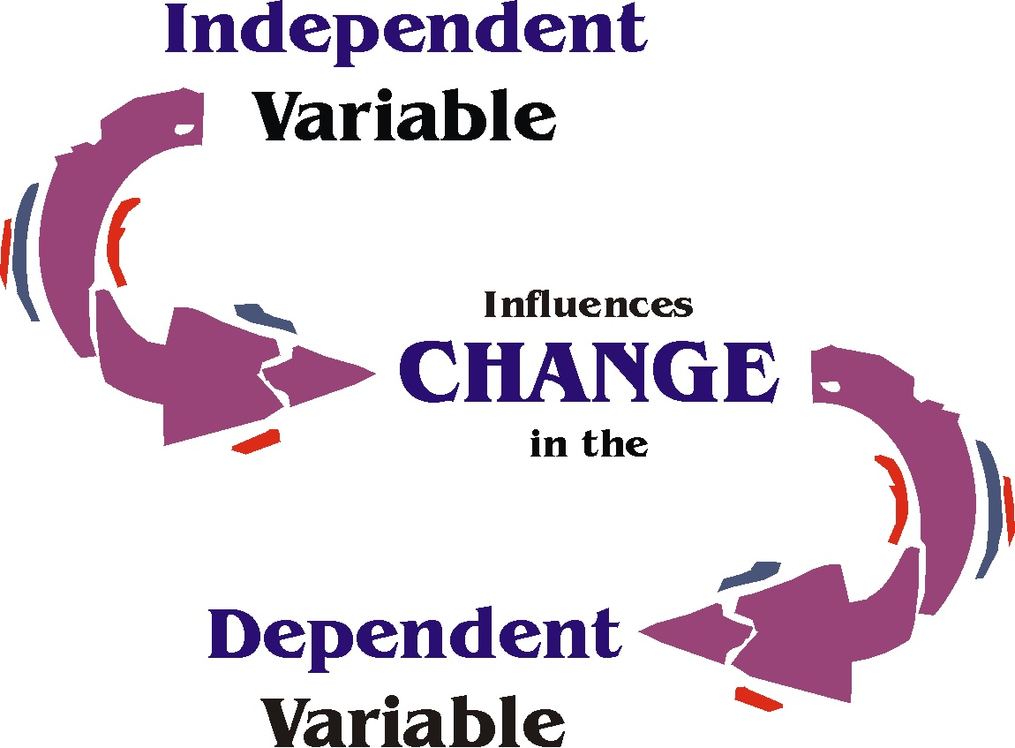
Data collection: what to measure?
→ Variables
things that can change or vary.

Slide 24
Independent X dependent
Coca cola is an effective spermicide (Umpierre, Hill and Anderson, 1985).
Hypothesis can be expressed in terms of two variables:
Proposed cause.
Proposed outcome.
Proposed cause = coca cola
Proposed effect = dead sperm
Cause = independent variable = its value does not depend on any other variable.
Effect = dependent variable = value depend on the cause.

Slide 25
Levels of measurement
Categorical and continuous
Categorical: entities are divided into distinct categories.
binary (only 2 categories)
nominal (more than 2 categories)
ordinal (logical order)
Continuous (entities get a distinct score)
Interval: equal intervals on the variables.
Ratio: the ratios of scores on the scale must make sense.

Slide 26
??? I am still lost!!!!
Categorical: can take only certain values, usually whole numbers. It is made of categories.
Ex.: species.
Continuous: can be measures in infinite level of precision.
Ex.: age.
Can you think in any other example???

Slide 27
Based on your own research question (set previously), write down the variables you wish to measure to answer your research question and classify them:

Slide 28
Measurement error
Different in results between laboratories.
Difference in methods.
Difference in weight between scales.
Keep it to a minimum!!!

Slide 29
Data collection: what to measure?
Correlational X Experimental research methods
- Correlational: we observe what naturally goes on in the world without directly interfering with it.
- Experimental: we manipulate one variable to see its effect on other.
Examples:
Correlational: to measure pollution levels, lifestyle, disease, worker’s job satisfaction.
Experimental examples: dating anxiety (Independent variable has different levels that are manipulated in different ways (usually including control group).

Slide 30
Two methods of data collection
- Manipulate the independent variable using different participants.
- Manipulate the same variables using the same participants (repeated measures).

Slide 31
What type of data collection will you use to answer your research question?

Slide 32
Randomization
Why is it important???
- Scientists use randomization to keep variation as small as possible and get more sensitive measure of the experimental manipulation.
- Each element of the frame has an equal probability of selection

Slide 33
Analyzing data
Final stage
Look at your data graphically.
Check what the general trends in the data are.
Fit a statistical model to the data.

Slide 34
How much have you learnt?
What are the five stages of research process?
What is the fundamental difference between experimental and correlational research?
Say I own 857 CDs. My friend has written a computer program that uses a webcam to scan the shelves in my house where I keep my CDs and measure how many I have. His program says that I have 863 CDs. Define measurement error. What is the measurement error in my friend’s CD- counting device?

Slide 35
What is the level of measurement of the follow variables?
The number of downloads of different band’s songs on iTunes.
The names of the bands that were downloaded.
The position in the iTunes download chart?
The money earned by the bands from the downloads.
The instruments played by the band members.
The time they have spent learning to play their instruments.

Slide 36
Data collection at Postgrad BBQ
Mighty Soft Bread Rolls Hamburger Buns | 15
Woolworths Select Mixed Grain Sandwich Bread | 6
Woolworths Select Wholemeal Sandwich Vitamins & Iron | 6
Masterfoods Barbecue Sauce Honey | 2
Masterfoods Mustard Honey Squeezy | 2
Masterfoods Tomato Sauce Australian Grown | 2
Homebrand Iodised Salt Drum | 1
Red Island Australian Extra Virgin Cold Pressed Olive Oil | 1
Woolworths Select Pepper Black Cracked | 1
Woolworths Select Margarine Spread Olive Oil | 2
Coca Cola Bottle | 8
Golden Circle Orange Fruit Juice | 4
Golden Circle Pine Orange Fruit Juice | 4
Schweppes Lemonade Bottle | 5
Fresh Cuts Salad Mix Baby Leaf With Beetroot | 7
Chinet Cutlery Plastic Forks | 8
Chinet Cutlery Plastic Knives | 8
Deeko Serving Entertainer Plastic Plates | 10
Homebrand Serviettes Plain | 5
Homebrand Serving Disposable Teaspoons | 15

Slide 37
Mighty Soft Bread Rolls Hamburger Buns | 15
Woolworths Select Mixed Grain Sandwich Bread | 6
Woolworths Select Wholemeal Sandwich Vitamins & Iron | 6
Masterfoods Barbecue Sauce Honey | 2
Masterfoods Mustard Honey Squeezy | 2
Masterfoods Tomato Sauce Australian Grown | 2
Homebrand Iodised Salt Drum | 1
Red Island Australian Extra Virgin Cold Pressed Olive Oil | 1
Woolworths Select Pepper Black Cracked | 1
Woolworths Select Margarine Spread Olive Oil | 2
Coca Cola Bottle | 8
Golden Circle Orange Fruit Juice | 4
Golden Circle Pine Orange Fruit Juice | 4
Schweppes Lemonade Bottle | 5
Fresh Cuts Salad Mix Baby Leaf With Beetroot | 7
Chinet Cutlery Plastic Forks | 8
Chinet Cutlery Plastic Knives | 8
Deeko Serving Entertainer Plastic Plates | 10
Homebrand Serviettes Plain | 5
Homebrand Serving Disposable Teaspoons | 15

